Slide 1

Fix My Broken Model
Customer Complaint Classifier Debugging
PREPARED BY: KWENA RACHELAPA

Slide 2






PROBLEM STATEMENT
The Scenario
The Mission
The Objective
A legacy model claimed 94% accuracy but failed completely when deployed to real South African telecom customers.
Identify 5 intentional bugs within broken_classifier.py and the data pipeline.
Create a fixed_classifier.py that is honest, robust, and ready for real-world use.

Slide 3


DATASET OVERVIEW
The dataset includes South African specific locations (e.g., Soweto, Sandton) and currencies (Rand) to reflect local market realities.
Volume: 2,000 synthetic complaints.
Imbalance: Heavily skewed toward Billing (60%).
Minority: Fraud accounts for only 10% of samples.

Slide 4


BUG 1: DATA LEAKAGE
The Bug: The model used complaint_id prefixes (BIL, NET, SVC, FRD) as a training feature.
The Problem: In production, new complaints don't have category-based IDs yet. The model was "cheating" instead of learning language.
Shortcut Detected
The Fix: Removed ID-based features to force learning from actual text.

Slide 5
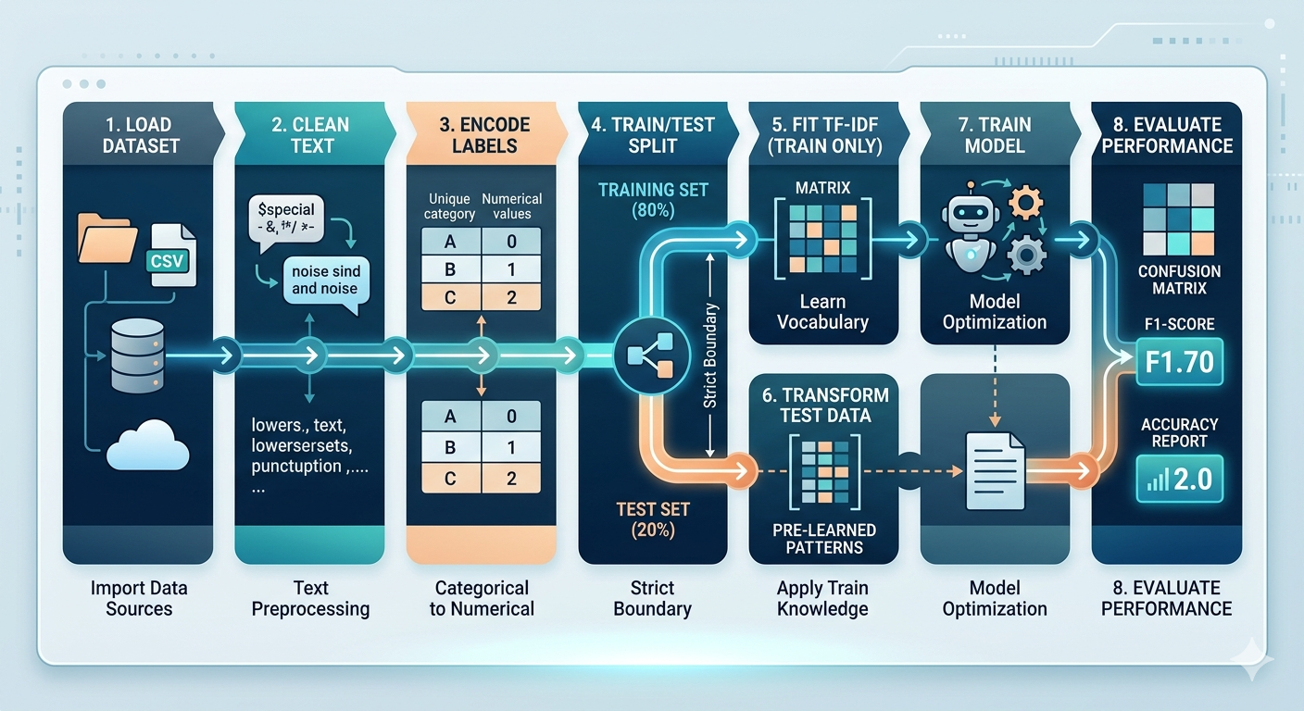
BUG 2 & 3: PIPELINE CONTAMINATION
The Bug: TF-IDF vectorization and feature engineering performed on the entire dataset before splitting.
The Problem: The model "saw" the test set vocabulary during training.
Re-architected Pipeline:
1. Clean Raw Text
2. Split 80/20 Train/Test
3. Fit TF-IDF only on Training Data

Slide 6
BUG 4: ACCURACY PARADOX
94%
The Bug: Original pipeline only reported "Accuracy".
The Risk: On imbalanced data, a model could ignore Fraud (10%) and still look good while losing the bank money.
The Fix: Full Classification Report (Precision, Recall, F1) and Confusion Matrix.

Slide 7

BUG 5: LABEL MISMATCH
The Bug: Classification report manually hardcoded names in the wrong order.
The Problem: LabelEncoder sorts alphabetically. "Network" results were showing under "Fraud".
# Mapping the Truth: target_names = le.classes_
The Fix: Dynamically mapped names using label_encoder.classes_.

Slide 8
FINAL MODEL PERFORMANCE
Class | Precision | Recall | F1
Billing | 1.00 | 1.00 | 1.00
Fraud | 1.00 | 1.00 | 1.00
Network | 0.77 | 0.85 | 0.81
Service | 0.83 | 0.75 | 0.79
Root Cause Diagnosis
The "Network/Service" gap is due to Noisy Labels in generate_dataset.py (~15% swapped labels).
The model is working at the maximum theoretical limit of the data quality.

Slide 9

FEATURE IMPORTANCE
1. days 0.1060
2. account 0.0561
Proof of Success
3. number 0.0329
Absence of "Cheat Features" proves success. The model now identifies days down and charge errors within the SA telecom context.
4. acc 0.0240
5. minutes 0.0180

Slide 10





CONCLUSION
Diverse Metrics
Data Isolation
Order Matters
Accuracy is a vanity metric in imbalanced datasets. Always analyze F1 and confusion matrices.
Strictly separate training logic from evaluation data. Leakage creates "magic" models that fail in production
The sequence of vectorization, feature scaling, and splitting is critical to model integrity.

Slide 11


IMAGE SOURCES
https://png.pngtree.com/png-clipart/20250623/original/pngtree-glowing-blue-digital-brain-with-intricate-circuit-patterns-a-high-resolution-png-image_21215423.png
Source: pngtree.com
https://media.craiyon.com/2025-10-01/2me9oecaTQmNwknt4TGQ9g.webp
Source: www.craiyon.com

